Slide 1
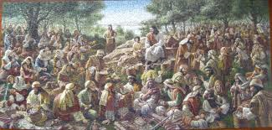
Centering Time
When Jesus looked out and saw that a large crowd had arrived, he said to Philip, “Where can we buy bread to feed these people?” He said this to stretch Philip’s faith. He already knew what he was going to do. Philip answered, “Two hundred silver pieces wouldn’t be enough to buy bread for each person to get a piece.” One of the disciples—it was Andrew, brother to Simon Peter—said, “There’s a little boy here who has five barley loaves and two fish. But that’s a drop in the bucket for a crowd like this.” Jesus said, “Make the people sit down.” There was a nice carpet of green grass in this place. They sat down, about five thousand of them. Then Jesus took the bread and, having given thanks, gave it to those who were seated. He did the same with the fish. All ate as much as they wanted. When the people had eaten their fill, he said to his disciples, “Gather the leftovers so nothing is wasted.” They went to work and filled twelve large baskets with leftovers from the five barley loaves.
John 6:5-13 The Message (MSG)
Share a time your congregation did
something that seemed small at first
but became bigger than imagined…

Slide 2
What Multi-Point Parishes Are Teaching Us
About Being Better Together

Slide 3
Lessons Learned…
The more members of each of the congregations know and understand each other, including familiarity with the history and traditions of each of the congregations, the better.
When each congregation is committed to building up the other, each partner is made stronger and more effective in ministry.

Slide 5
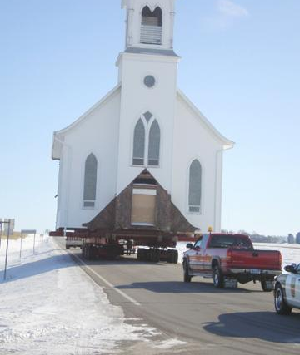
What’s Moving Your Congregations in Your Parish?
Traditionalism / nostalgia
Personalities
Finances
Programs / events
Buildings
God’s mission
nature of the church + context where church is planted + engaging God’s mission in that context = purpose (role) for the church in that context and time

Slide 6
The Church is…
The Church does what it is…
The Church organizes to do what it is…
The Essence of the Church: A Community Created by the Spirit
by Dr. Craig Van Gelder

Slide 7
Lessons Learned…
Recognize, acknowledge and affirm
Rolling up sleeves instead wringing hands
God provides what you need to do what God is calling you to do
Identity as an Asset Instead of a Liability
Achieve unity through diversity rather than unity through similarity.
Form a complimentary whole that is strengthened by different assets.
What are the strengths of each of the congregations?

Slide 8
Lessons Learned…
Be intentional about cooperating
Redirection of energy from competition to cooperation can release new potential for ministry.
Barriers are overcome by mutual affirmation of the partners.
Lead as a team
Team building is essential.
Laity and Pastor working together is crucial.
Purposefully flexible
Have a written agreement annually reviewed and adjusted as needed

Slide 9
S.O.A.R.: A framework for vision and mission
Strengths: What has God already placed in our midst that God can build upon through us?
Opportunities: What are the “opportunities” for mission God reveals in this community?
Aspirations: What is God placing on our hearts that we deeplycare about /want deeply to happen?
Results: What’s one thing God is calling us to see, that we could do together?
Notes:
Here are the basic questions…
9

Slide 10
Prayer by Pr Ted Schroeder
Lord, we come into your presence seeking a gracious blessing. But we dare to ask for an outrageous portion of your grace. We ask that you not simply equip us, but that you chase us out into your world.
Make us people of vision who look not in but out, not backward but forward, not down but up, not at what cannot be done but at what might be accomplished by your Spirit.
Make us those who seek narrow paths instead of wide and easy ways, sending us new places instead of resting places, starts instead of finishes, horizons instead of waysides, tomorrows instead of yesterdays.
Give us running shoes instead of slippers, alarm clocks instead of sleep switches, accelerators instead of brakes, sailboats instead of sandcastles.
Make us startle even ourselves with the power that you give. For all we do is moved by your breath, enveloped by your Spirit, filled with the wind of Your grace, and resounding to your glory and not ours.
We pray in Jesus’ name.

